Slide 1
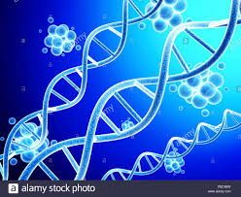
DNA Structure
For B.Sc. Part I (Subs.) (Group B)
Presented by:
Dr. Ankit Kumar Singh
Assistant Professor
Department of Botany
Marwari College
Lalit Narayan Mithila University
Darbhanga
ankitbhu30@gmail.com
Lecture No. 22

Slide 2
DNA (Deoxyribonucleic Acid)
DNA was first discovered by F. Meischer (1869) from pus cells (as nuclein)
Nucleic acids (DNA) are polymer of Nucleotides.
In DNA, each nucleotide is made up of three parts: a 5-carbon sugar called deoxyribose, a phosphate group, and a nitrogenous base.
Nucleoside = Nitrogen base + pentose sugar
Nucleotide = Nitrogen base + pentose sugar + phosphate
Sugar molecule : Represented by a pentose sugar the deoxyribose or 2-deoxyribose which derived from ribose due to the deletion of oxygen from the second carbon.
In deoxyribose X= H and in ribose X= OH

Slide 3
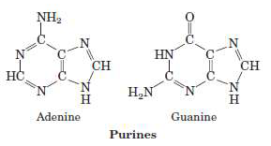
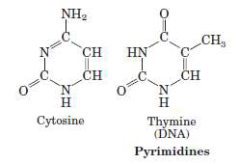
Purines : Purines are 9 membered double ringed nitrogenous bases which possess nitrogen at 1', 3',7' and 9' positions. They are adenine (A) and guanine (G).
Pyramidine: They are smaller molecule than purines. These are 6 membered single ringed nitrogenous bases that contain nitrogen at 1' and 3' positions like cytosine (C), thymine (T) and uracil (U).

Slide 4
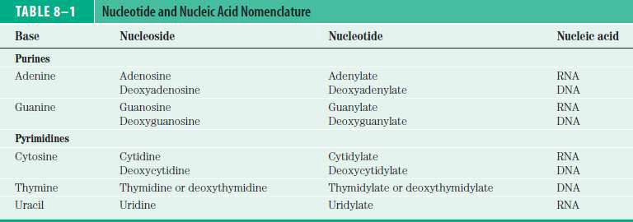
Phosphoric acid : H3PO4 that makes DNA acidic in nature
Table: Nucleotide and nucleic acid nomenclature
Nitrogen base form N-glycosidic linkage with first carbon of pentose sugar to form a nucleoside.
Nitrogen of first place (N1) form bond with sugar in case of Pyrimidines while in purines nitrogen of ninth place (N9) form bond with sugar.

Slide 5
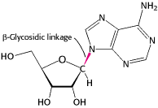
The base lies above the plane of sugar when the structure is written in the standard orientation
The configuration of the N-glycosidic linkage is β .
Phosphate form Phosphoester bond (covalent bond) with fifth Carbon of sugar to form a complete nucleotide.
The successive nucleotides of DNA covalently linked through phosphate-group “bridges”
5-phosphate group of one nucleotide unit is joined to the 3-hydroxyl group of the next nucleotide.
Two nucleotides are linked through 3’-5’ phosphodiester linkage to form a dinucleotide. More nucleotide can be joined in such a manner to form a polynucleotide.

Slide 6
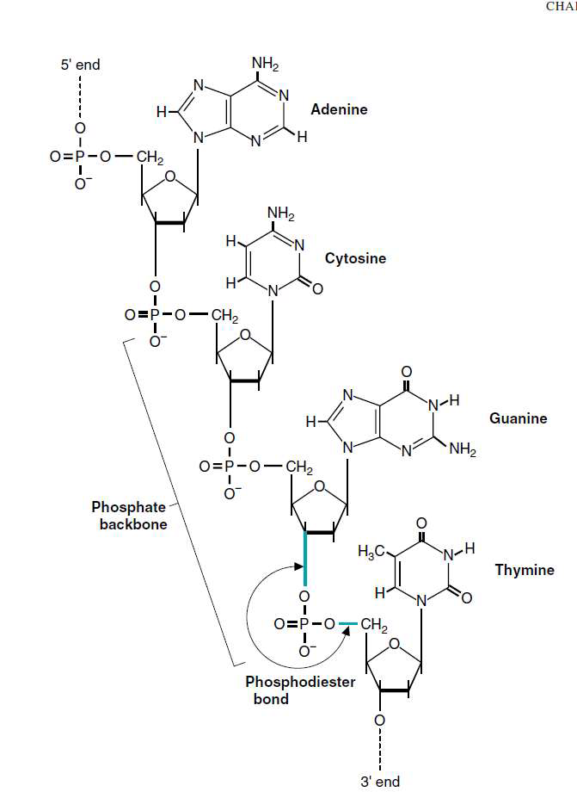
A polymer thus formed has at one end a free phosphate moiety at 5’-end of pentose sugar, which is referred to as 5’ – end of polynucleotide chain. Similarly, at the other end of the polymer the pentose has a free 3’-OH group which is referred to as 3’-end of the polynucleotide chain.

Slide 7
The condensation most commonly occurs between the alcohol of a 5-phosphate of one nucleotide and the 3-hydroxyl of the second with the elimination of H2O, forming a phosphodiester bond.
The formation of phosphodiester bond in DNA and RNA exhibits directionality.
The linear arrangement of nucleotides (Primary structure) proceeds in 5 to 3 direction.
The backbone consists of the phosphate sugar chain that runs the length of the polynucleotide.
The base pairing of nucleotides give secondary structure.
For DNA most important secondary structure consists of a double helix(two strands) held together by hydrogen bonding between the bases.
Structure of double stranded DNA
Wilkins and Franklin studied DNA molecule with the help of X-ray crystallography.
With the help of this study, Watson and Crick (1953) proposed a double helix model for DNA. For this model Watson, Crick and Wilkins were awarded by noble prize in 1962.
The Watson-Crick double helix model describes the features of the B form of DNA.
However, there are also many form of DNA (A and Z forms) distinct from B form of DNA.

Slide 8
Chargaff's Rule
Erwin Chargaff (1950): Proposed two rules which is known as Chargaff's rule
First rule: In a double stranded DNA amount of purine nucleotides is equals to amount of pyrimidine nucleotides i.e. [A] + [G] = [T] + [C]
The proportion of A is equal to T and so also of G is equal to C. but amount of [A] +[T] is not necessarily equal to [G] + [C]. Therefore, [A] = [T] ; [G] = [C].
Second rule: the composition of DNA varies from one species to another.
The chargaaf’s rule is not valid (true) for RNA. It is valid only for double helical DNA. i.e. for RNA it is A ≠ U and G ≠ C.
Important features of Watson and Crick double helical model (B-form) of DNA
The double helix comprises of two polynucleotide chains.
Both polynucleotide chains are anti-parallel and Complementary to each other.
Each polynucleotide chain has a sugar-phosphate ‘backbone’ with nitrogeneous bases directed inside the helix.

Slide 9
Both strand of DNA held together by Hydrogen bonds. This H-bond are present between nitrogen bases of both strand. There are two hydrogen bonds between A and T, and three between G and C.
In both strand of DNA direction of phosphodiester bond is opposite. i.e., If direction of phosphodiester bond in one strand is 3’→5’ then it is 5’→3’ in another strand.
The diameter of the helix is 20 Å (2nm).
The bases are nearly perpendicular to the helix axis, and adjacent bases are separated by 3.4 Å.
The helical structure repeats every 34 Å (0.34 nm), so there are 10 bases (= 34 Å per repeat/3.4 Å per base) per turn of helix.
There is a rotation of 36 degrees per base (360 degrees per full turn/10 bases per turn).
B- DNA, right handed, 10 base pairs per turn.
Spatial arrangement of two strands creates Major (wide) & minor (narrow) Groove.
Bases are perpendicular to axis, sugars are at right angle to those of bases.

Slide 10
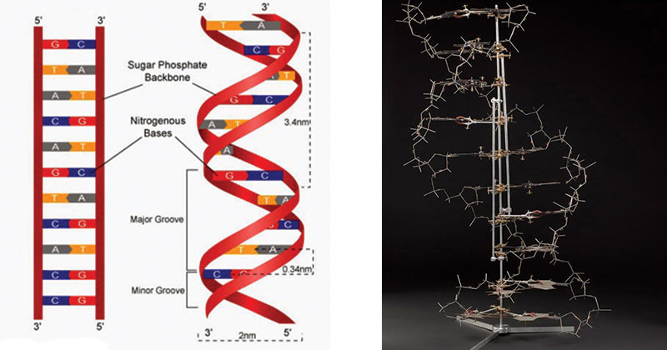
Figure: DNA double helix (Watson and Crick model of DNA)

Slide 11
Geometry | A-Form | B-Form | Z-Form
Helix sense | right-handed | Right handed | Left handed
Repeat unit | 1bp | 1 bp | 2bp
Mean bp/turn | 10.7 | 10.4 | 12
Diameter | 23 Aͦ | 20 Aͦ | 18Aͦ
Major groove | Narrow and deep | Wide and deep | Flat
Minor groove | Wide and shallow | Narrow and deep | Narrow and deep
Table: Comparison of different forms of DNA
Dr. Ankit Kumar Singh
Assistant Professor
Department of Botany
Marwari College
Lalit Narayan Mithila University
Darbhanga
ankitbhu30@gmail.com
Thank You!!!

